Slide 1
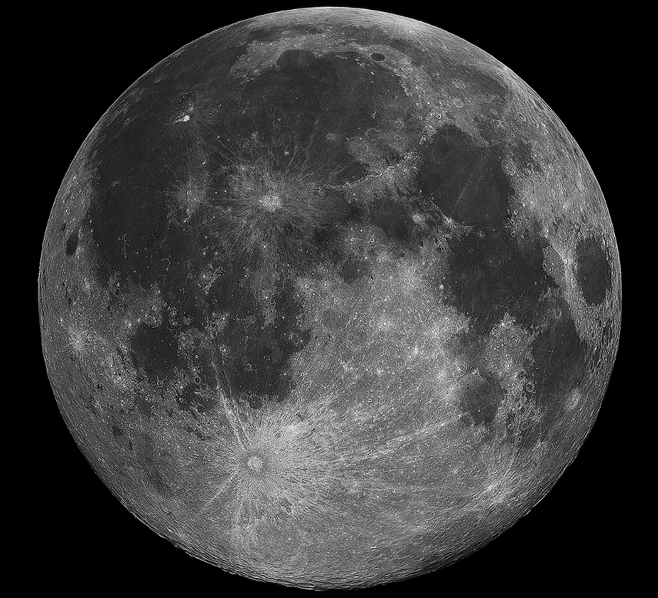

UNDERGRADUATE
PROJECT I
Department of Electrical Engineering
Arpit Anand (210190)
Anjali Jangir (210144)
Supervisors :
Dr. Tushar Sandhan
Dr. Kunal Mooley
PG Mentor
Sahil Maurya

Slide 2
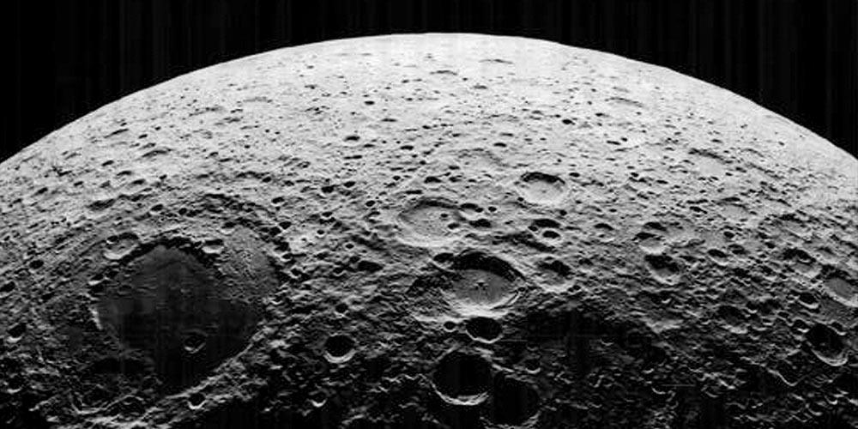
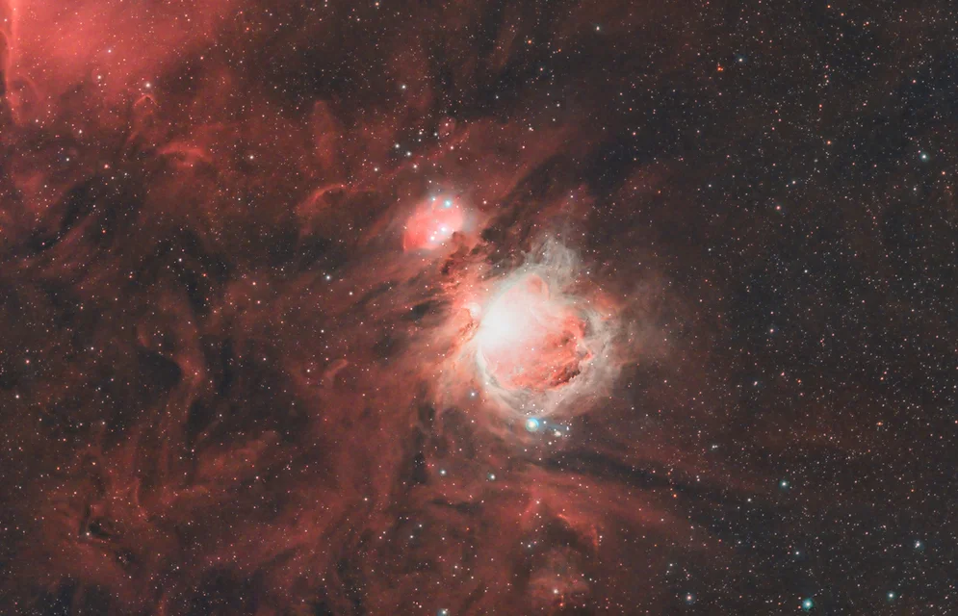
PROBLEM STATEMENT
LUNAR surface image 2D SUPER-RESOLUTION using neighbouring information.
Carrying 2D image SUPER-RESOLUTION to Deep Space Objects and further carrying it forward the super resolution to 3D MODELLING of these objects like Nebulae (Future Scope).

Slide 3
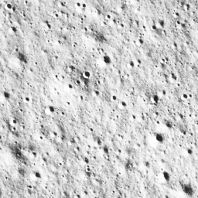


GATHERING DATASET
Our dataset includes data from ISDA (ISRO Science Data Archive) of CHANDRAYAAN 2’s OHRC (Optical High Resolution Camera).
Raw images of size 12000X9000px were taken and then cropped into 256X256px processed images.
These 256X256px images were downsampled to 64X64px and 128X128px.
Training Set includes 1744 images of various resolution (256X256px, 128X128px, 64X64px).
Testing Set includes 569 images of various resolution (256X256px, 128X128px, 64X64px).
Raw Dataset: GSD (Ground Sampling Distance) = 0.25m; Swath = 3km; Altitude= 100km.

Slide 4
APPROACHES
SRCNN (Super-Resolution Convolutional Neural Network)
FSRCNN (Fast Super-Resolution Convolutional Neural Network)
SRGAN (Super-Resolution Generative Adversarial Network)
ESRGAN (Enhanced Super-Resolution Generative Adversarial Network)
FEAT-UP

Slide 5
SRCNN
MODEL ARCHITECTURE:
SRCNN is a Deep Learning Convolutional Neural Network model used for single image super resolution.
It consists of three major components:
PATCH EXTRACTION and REPRESENTATION: Extracting low resolution patches and representing them as feature vectors.
NON-LINEAR MAPPING : Mapping low resolution feature vectors to high resolution feature vectors using Convolutional layers.
RECONSTRUCTION: Reconstructing the high-resolution image from high-resolution feature vectors.

Slide 6
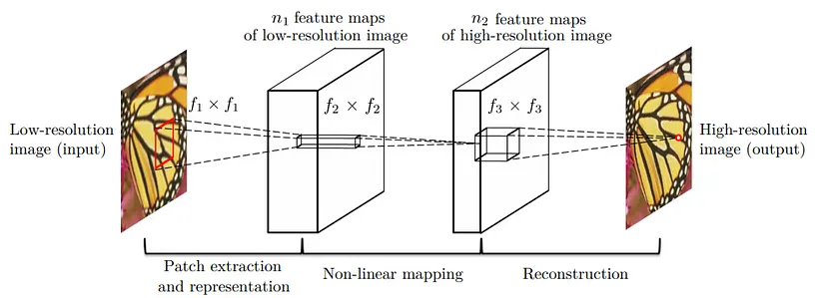
SRCNN
MODEL ARCHITECTURE:

Slide 7
SRCNN
MODEL IMPLEMENTATION:
The LR image is interpolated to same size as of HR image using Bicubic Interpolation.
The first layer convolves the input image using a 9*9 kernel with padding, resulting in 64 feature maps. These feature maps capture essential information from the input.
The second layer performs a non-linear mapping, applying a 1*1 kernel to condense the feature maps to 32 feature maps. This step enhances the representation of features, allowing the network to learn more complex relationships.
The final layer reconstructs the HR image.
The model was trained to maximise the PSNR (Peak-Signal-to-Noise-Ratio) and minimise the MSE (Mean-Squared-Error) taken as loss function while training the model.
We used metrics like MSE, PSNR, and SSIM to compare between the Reconstructed Image and the Ground Truth image.

Slide 8
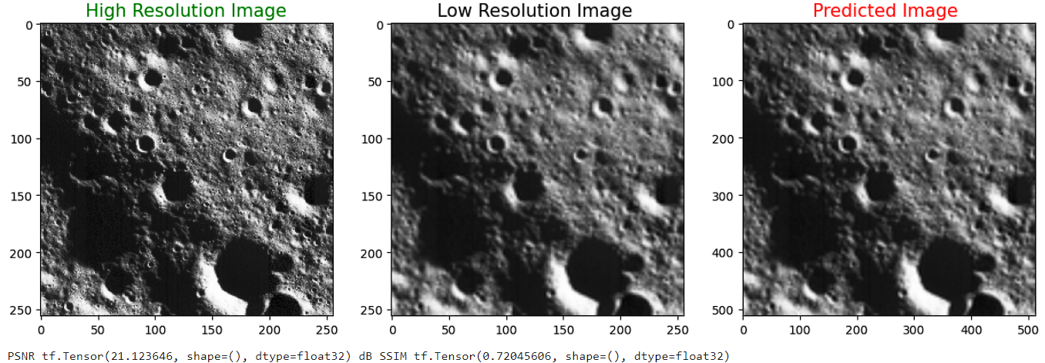
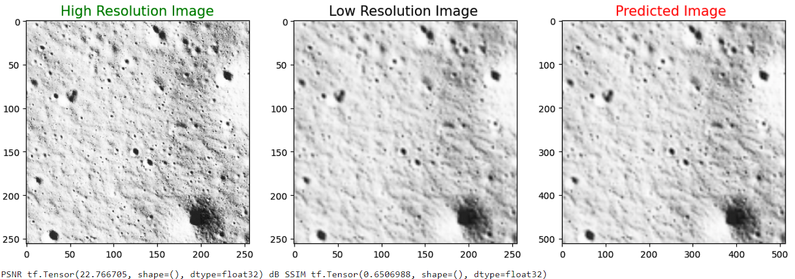
RESULTS:
Model was trained for 14 epochs.
MSE loss = 0.0087
Val loss = 0.0111
PSNR Values ranges from 21.5 to 23 dB.
SSIM Values ranges from 0.65 to 0.72 .

Slide 9
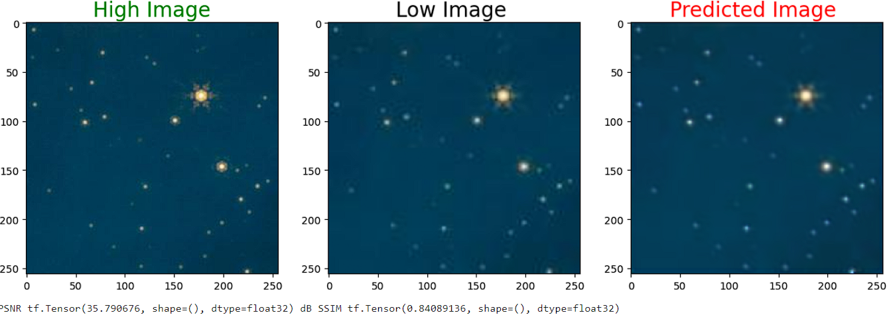
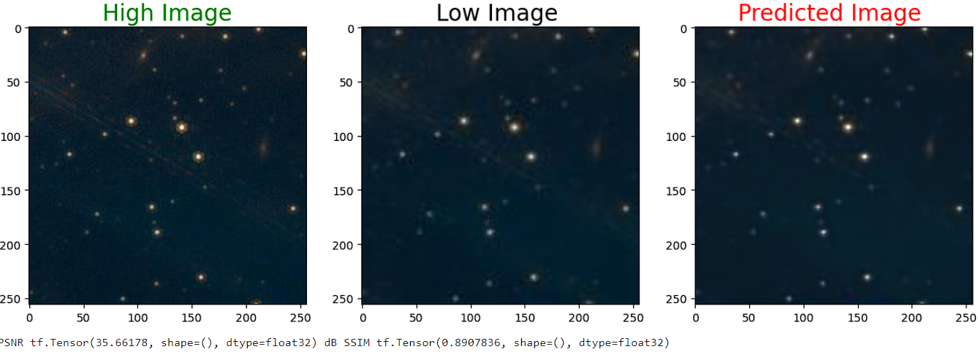
RESULTS: DEEPSPACE
Model was trained for 14 epochs.
MSE loss = 9.4791e-04
Val loss = 3.0963e-04
PSNR Values ranges from 34.5 to 35.5 dB .
SSIM Values ranges from 0.84 to 0.89 .

Slide 10
FSRCNN
MODEL ARCHITECTURE:
It consists of 5 main featured layers:
FEATURE EXTRACTION LAYER: Extracting low-level features and representing them as feature vectors and ReLU introduces non linearity in the model.
SHRINKING LAYER: Reduces the dimensionality of the feature maps obtained in Feature Extraction layer. Fewer filters convolution layer is employed.
NON-LINEAR MAPPING : Learn high-level feature representations that encode both local and global image characteristics.
EXPANDING LAYER: Aimed to enrich the feature representations obtained from Non-Linear mapping. ReLU enhances the expressive power of feature representation.
DECONVOLUTION LAYER: Upsample the feature maps to the high resolution image of desired size. Consists of deconvolution operations.

Slide 11
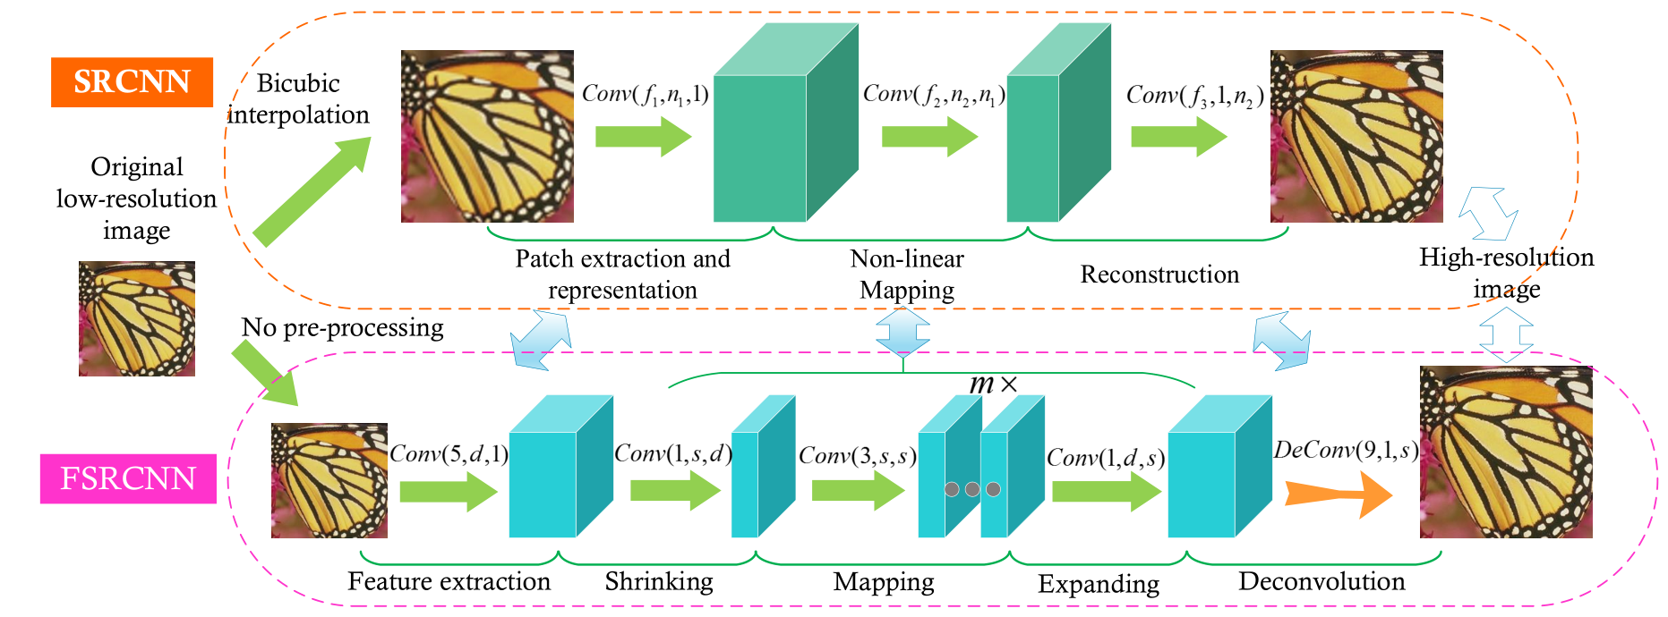
FSRCNN
MODEL ARCHITECTURE:

Slide 12
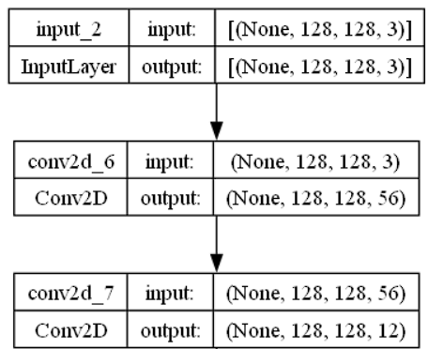
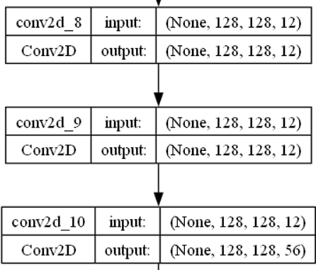
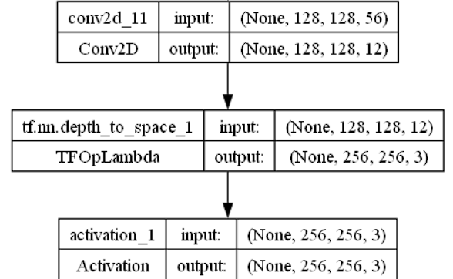
FSRCNN
MODEL IMPLEMENTATION:
The model was trained to maximise the PSNR (Peak-Signal-to-Noise-Ratio) and minimise the MSE (Mean-Squared-Error) taken as loss function while training the model.
We used metrics like MSE, PSNR, and SSIM to compare between the Reconstructed Image and the Ground Truth image.

Slide 13
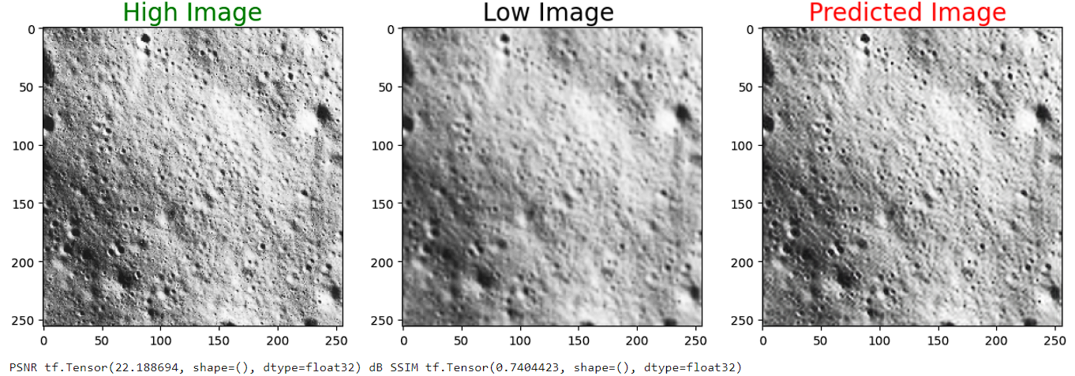
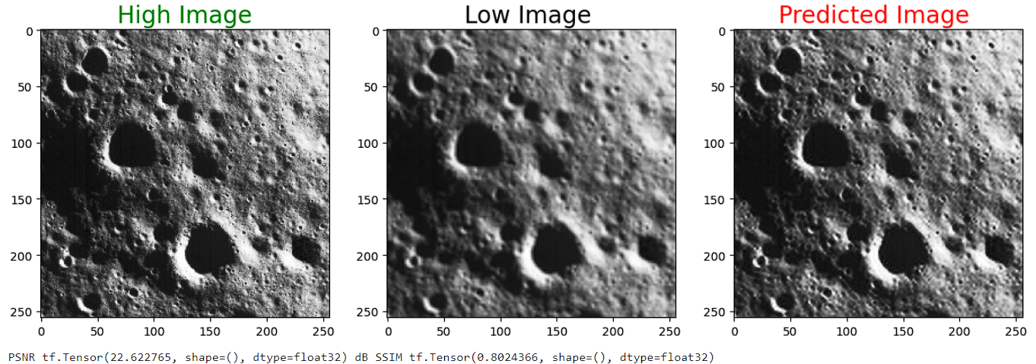
RESULTS:
Model was trained for 14 epochs.
MSE loss = 0.0078
Val loss = 0.0109
PSNR Values ranges from 22.5 to 24 dB.
SSIM Values ranges from 0.74 to 0.8 .

Slide 14
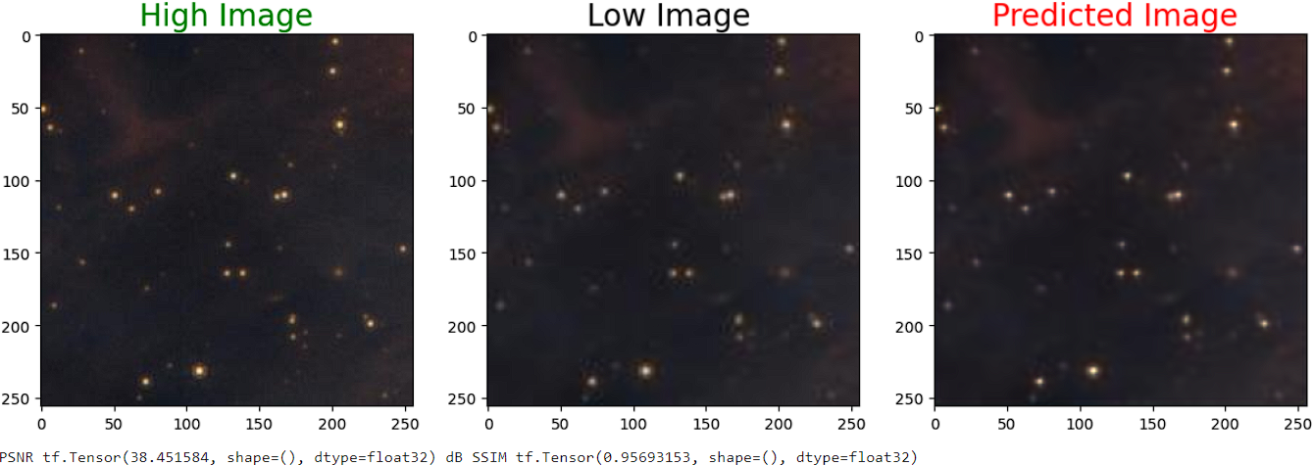
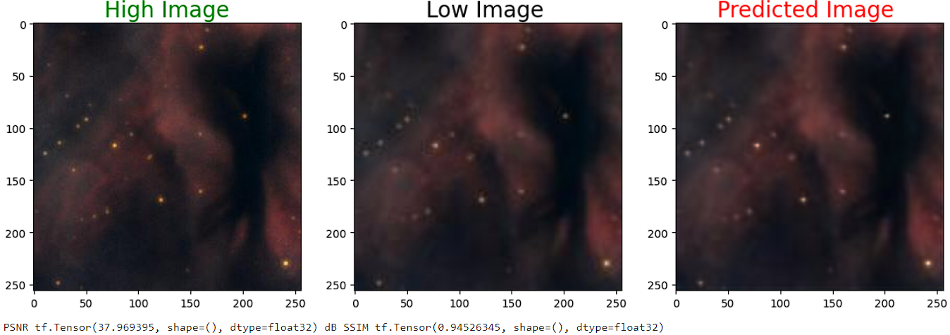
RESULTS: DEEPSPACE
Model was trained for 14 epochs.
MSE loss = 5.9512e-04
Val loss = 2.5327e-04
PSNR Values ranges from 37 to 38 dB.
SSIM Values ranges from 0.94 to 0.95 .

Slide 15
Difference between SRCNN and FSRCNN:
FSRCNN adopts the original at the end of the network to perform upsampling.
The non-linear mapping step in SRCNN is replaced by 3 steps, Shrinking, Mapping and expanding step.
FSRCNN introduces a deconvolutional layer at the end of the network. This allows learning directly from the original LR image (without bicubic interpolation) to the HR image.
FSRCNN uses smaller filter sizes but includes more mapping layers.
FSRCNN achieves a speedup of more than 40 times as compared to SRCNN while maintaining superior restoration quality.
By comparing SRCNN and FSRCNN, FSRCNN has a better PSNR (image quality) and much shorter running time.

Slide 16
SRGAN Method
Estimating a High resolution image from it Low resolution counterpart.
Key points about SRGAN:
Architecture Components :
Generator:
Produces HR from LR inputs.
Uses Residual networks for training.
Skip connections within residual blocks for deeper networks. (Our
thought process)
Discriminator:
Distinguish between original HR image and generated super-resolution
image. (ReLU architecture)

Slide 17
Perceptual Loss Function:
Content Loss:
It measures perceptual similarity b/w super-resolved images and the ground truth (High-resolution) images.
Adversarial
Encourages the generator to produce highly realistic super resolution images. Leverages a discriminator network. (The generator tries to minimize the loss, while the discriminator tries to maximize it.)

Slide 18
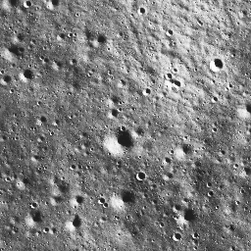
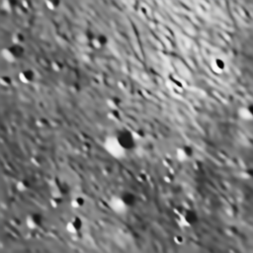

RESULTS
AVERAGE PSNR VALUED SUPER-RESOLVED IMAGE:
—-
LR
Ground Truth Super- Resolved
PSNR VALUE: 24.387535389397478 dB SSIM: 0.7454895233450496

Slide 19
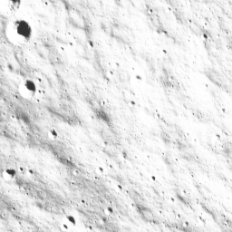
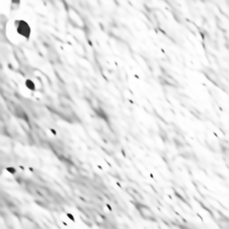

RESULTS
POOR PSNR VALUED SUPER-RESOLVED IMAGE:
PSNR VALUE: 19.8033435689968 dB SSIM: 0.69292757798687439

Slide 20
ESRGAN
Residual-in-residual dense block (RRDB) implementation.
The generator model in ESRGAN is similar to SRGAN, but with the modified residual block. Batch normalization layers are removed from every residual block, leading to improved performance and reduced computational complexity.
Uses relativistic loss, which measures the ‘relative’ reality between images. The discriminator predicts whether the real HR image is more realistic than the generated ones.
ESRGAN uses sub-pixel convolution layers for upsampling.

Slide 21
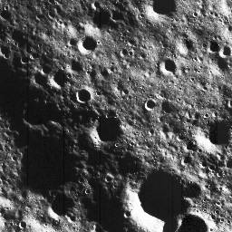
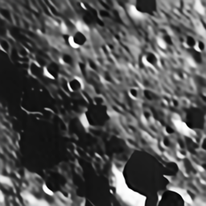
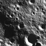
AVG PSNR VALUED SUPER-RESOLVED IMAGE:
LR
Ground Truth Super-resolved
PSNR: 24.790538351590257 dB SSIM: 0.7520313764042425

Slide 22
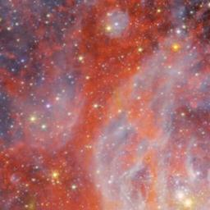


DEEP SPACE OBJECT
LR
GROUND TRUTH SUPER-RESOLVED
PSNR: 38.372670999430703 dB SSIM: 0.88922063095860494

Slide 23
FEAT-UP METHOD
A novel framework to improve the resolution of any image’s features without changing their original meaning or orientation.
A fast CUDA implementation of Joint Bilateral Upsampling (JBU) orders of magnitude more efficient than a standard PyTorch implementation and allowing guided upsampling in large-scale models.
Adaptive filters are commonly used to enhance images while preserving their underlying structure and content.
Bilateral filters apply a spatial filter to a LR image and an intensity filter to a HR guidance to blend information from the two.
JBU uses this technique to upsample a LR signal with a HR guidance.

Slide 24
The core intuition behind FeatUp is that one can compute HR features by observing multiple different views of LR features.
First we generate LR feature views to refine into a single HR output. By this, we perturb the input image with small pads, scales and horizontal flips and apply the model to each transformed image to extract a collection of LR feature maps.
Then we construct a consistent HR feature map from these views.
Downsample the HR features into LR features.
Compare downsampled feature to the true model outputs using a Gaussian likelihood loss.
JBU is feedforward upsampler.

Slide 25
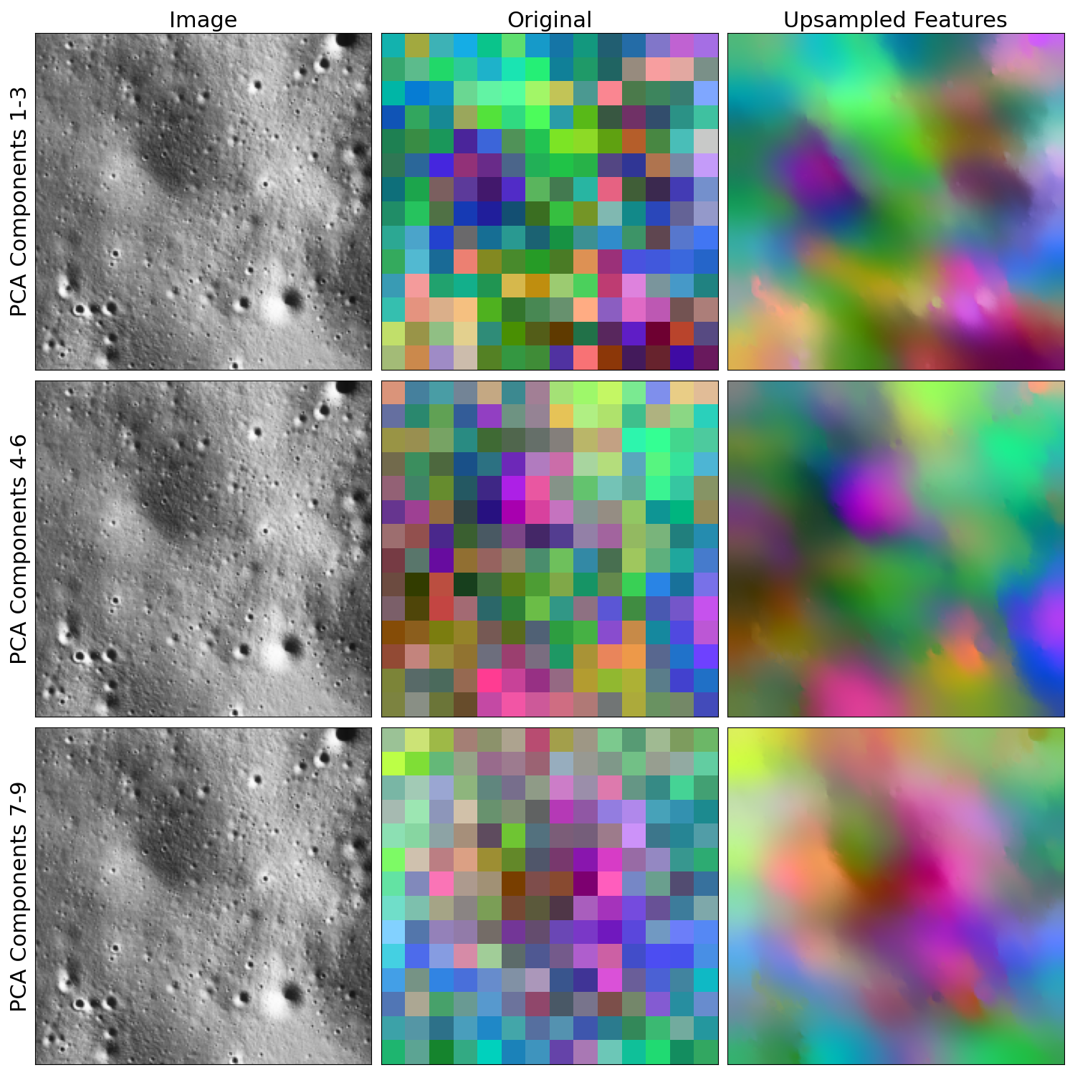
RESULTS
GOOD QUALITY SUPER-
RESOLVED IMAGE BY FEAT-UP
METHOD.
PSNR: 28.025689745685 dB
SSIM:0.852496357152

Slide 26
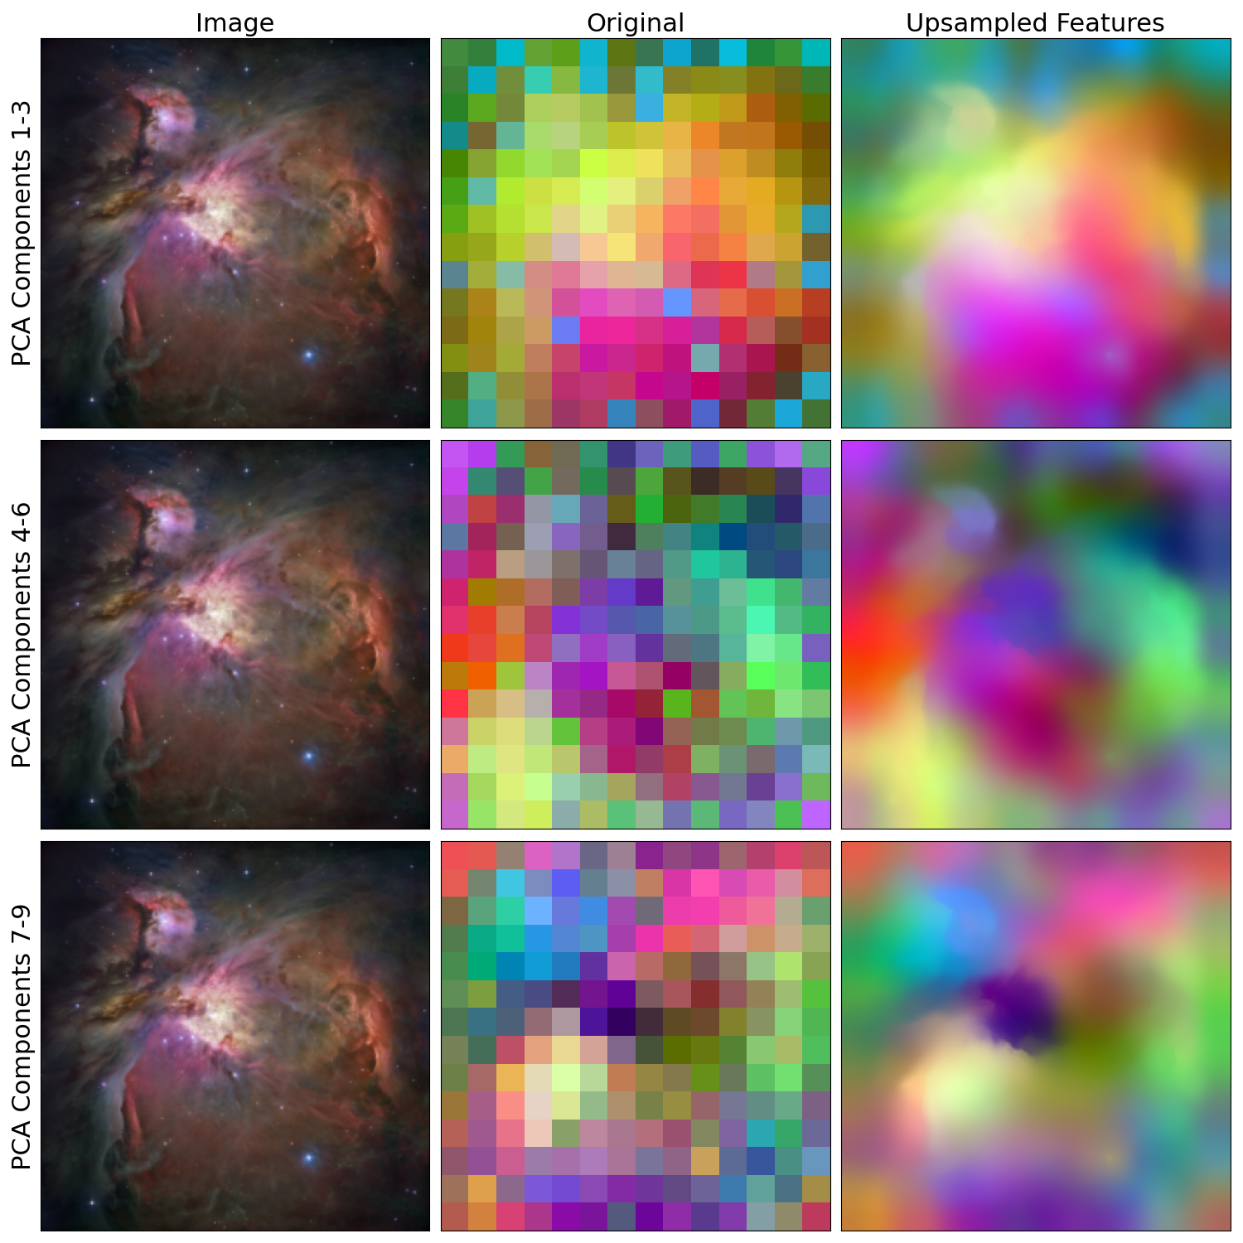
DEEP-SPACE
OBJECT
GOOD QUALITY ORION SUPER-
RESOLVED IMAGE USING
FEAT-UP METHOD
PSNR: 40.128946705462385 dB
SSIM: 0.899245896375127990

Slide 27
OVERALL RESULTS
PSNR and SSIM text files are uploaded in drive.
Quick Summary of all approaches:
 | SRCNN | FSRCNN | SRGAN | ESRGAN | FEAT-UP
AVG. PSNR(dB) | ~22 dB | ~22.5 dB | ~24 dB | ~26 dB | ~27.4 dB
AVG. SSIM | ~0.71 | ~0.73 | ~0.75 | ~0.77 | ~0.8

Slide 28
SOME COMMON(POOR, AVG, GOOD) PSNR VALUES:
POOR PSNR RANGE, ESPECIALLY FOR THE IMAGES
WHICH CONTAINS LOTS OF CRATERS AND MOSTLY
THE FULLY DARK IMAGES.
AVERAGE PSNR VALUE OF THE DATASET, ESPECIALLY
FOR THE IMAGES WHICH CONTAINS TINY PITS AND
GRAY IMAGES.
GOOD PSNR RANGE, WITH LESS NOISE IMAGE
GOOD QUALITY GRAY IMAGES.
16.659034897837167
17.189868525030107
18.669439585959786
19.182296816890553
24.446706916209063
24.387535389397478
24.20179821844087
24.133598846257133
27.346079056216656
28.99380882725409

Slide 29
PRACTICAL ASPECT
LUNAR BASE CONSTRUCTION: As space organizations like ISRO, plan for future manned missions with the intent of establishing a lunar base, super-resolved images are essential. They help in selecting optimal locations for bases by assessing factors such as terrain stability, access to possible water ice, and sunlight exposure.
EDUCATIONAL AND PUBLIC ENGAGEMENT: Enhanced lunar images serve educational purposes by providing detailed visuals for textbooks, documentaries, and interactive media to promote science education.
HISTORICAL ANALYSIS: Comparing current HR images with past images can provide insights into how the Moon’s surface has changed over time.
SPACE MISSIONS PLANNING: HR maps can help identify safe landing sites, understand the local terrain, and plan routes for rovers to navigate the surface.

Slide 30
FUTURE SCOPE for NEBULAE
Due to large distance, only a single projection of a nebula is ever visible from the earth. This precludes us from directly deducing 3D, volumetric models for visualization or scientific analysis.
A recent optimization approach views the symmetric reconstruction as a special kind of tomographic reconstruction problem.
The volume is tomographically reconstructed from several copies of the observed image rotated about the axis of symmetry.
Here we have to find a maximally symmetric volume ρ subject to a given image s by solving a group sparsity problem.
To solve this type of problem we adapt fast iterative shrinkage thresholding
algorithm.

Slide 31
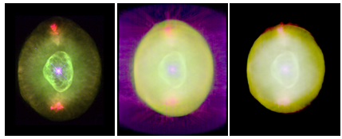
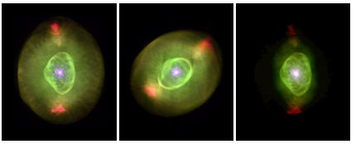

Slide 32
Thank You
All reference are upload in the Document folder in the Google Drive

